Slide 1


Hope to Skills
Lecture# 21
Irfan Malik, Dr. Sheraz Naseer

Slide 2
Agenda
Model Evaluation
Evaluation Metrics
Accuracy
Precision
Recall
F1-Score
AUC ROC Curve

Slide 3
Previous lecture:
Lecture 20 - Evaluation Metrics I
Click Heres

Slide 4
Why Evaluate Machine Learning Models?
Improved decision-making: Evaluation shows how well a model works, guiding choices about deployment and improvement.
Overfitting Prevention: Evaluation can warn against models that might memorize training data but do poorly on new data.
Fine-tuning: Assessment enables us to tweak the model improving its effectiveness.
Fair Comparison: It enables us to objectively compare different models.

Slide 5
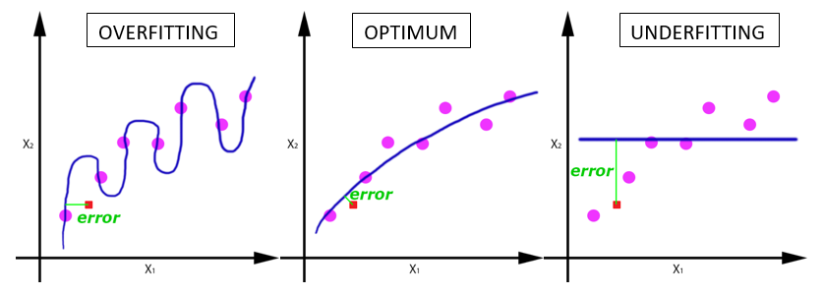
What is Underfitting?
Too Simple: An underfit model fails to capture the underlying pattern of the data.
Poor Performance: This leads to errors on both the training set and unseen data.
Example: Trying to fit a straight line to data that has a clear curve.

Slide 6
What is Overfitting?
Too Complex: An overfit model learns the training data too well.
Memorization, not Generalization: It becomes a lookup table rather than a pattern detector.
Poor performance on new data: The model becomes overly specific to the training data and makes bad predictions on unseen examples.

Slide 7
Consequences of Overfitting and Underfitting
Inaccuracy: Both lead to unreliable predictions.
Underfitting: High bias, the model consistently gets it wrong in a certain way.
Overfitting: High variance performance wildly depends on the specific data it has seen.

Slide 8
Consequences of Overfitting and Underfitting

Slide 9
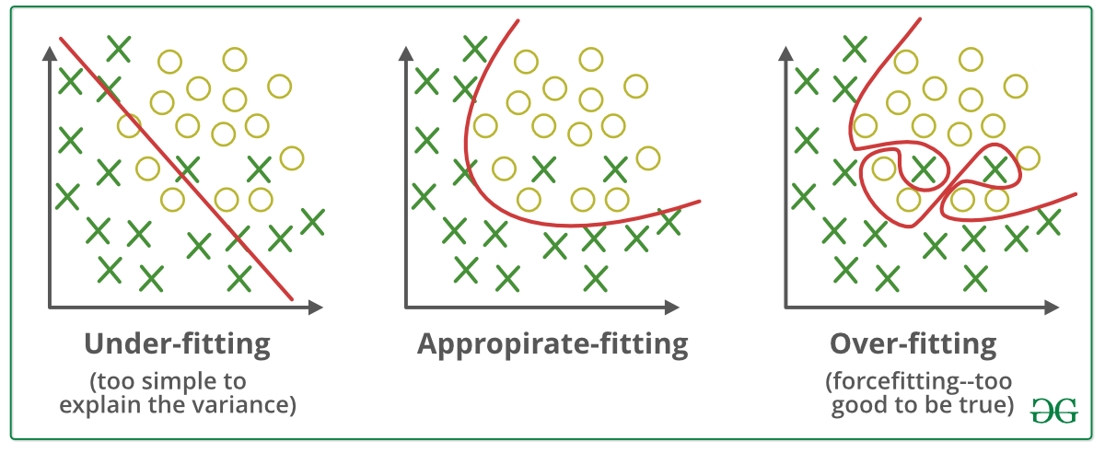
Our Goal

Slide 10
Basics - Training, Validation, and Testing Data
Training Data: We feed this data into a machine learning algorithm to develop a model.
Validation Data: This dataset tunes model parameters (hyperparameters), helping prevent overfitting.
Testing Data: Provides a final, unbiased picture of how well the model performs on unseen data.

Slide 11
Key Evaluation Metrics (Classification)
Accuracy
Precision
Recall
F1-Score

Slide 12
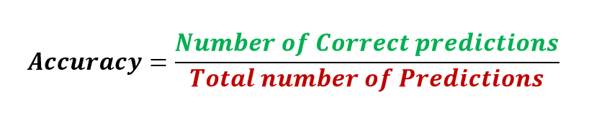
Accuracy
It is the ratio of number of correct predictions to the total number of input samples.
Note:It works well only if there are equal number of samples belonging to each class.

Slide 13
Accuracy- Example
Consider that there are 98% samples of class A and 2% samples of class B in our training set. Then our model can easily get 98% training accuracy by simply predicting every training sample belonging to class A.
When the same model is tested on a test set with 60% samples of class A and 40% samples of class B, then the test accuracy would drop down to 60%.
Classification Accuracy is great, but gives us the false sense of achieving high accuracy.
The real problem arises, when the cost of misclassification of the minor class samples are very high.

Slide 14
Possible Scenarios
True Positives (TP): Things your model predicted positive that were genuinely positive.
False Positives (FP): Things your model predicted as positive, but that were actually negative.
True Negatives (TN): Things correctly predicted as negative.
False Negatives (FN): Things incorrectly predicted as negative, when they were positive.

Slide 15
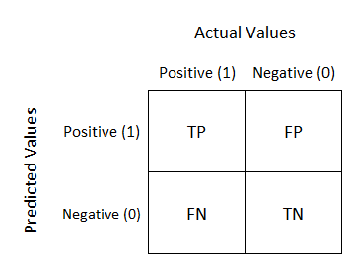
Confusion Matrix
Confusion Matrix as the name suggests gives us a matrix as output and describes the complete performance of the model.

Slide 16
Confusion Matrix
True Positives : The cases in which we predicted YES and the actual output was also YES.
True Negatives : The cases in which we predicted NO and the actual output was NO.
False Positives : The cases in which we predicted YES and the actual output was NO.
False Negatives : The cases in which we predicted NO and the actual output was YES.

Slide 17
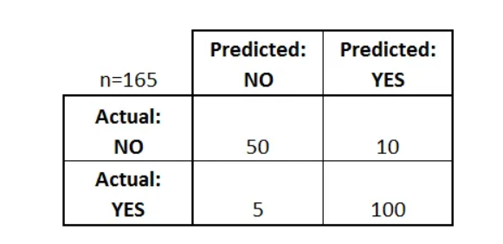
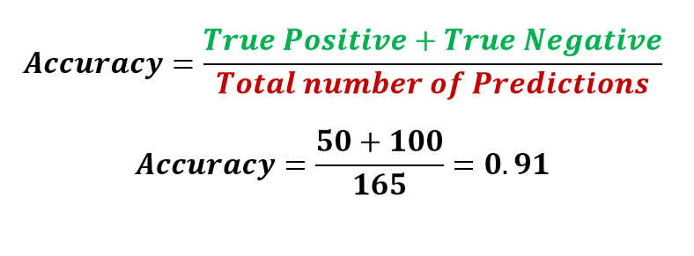
Confusion Matrix - Accuracy
Note: Only reliable when we have balanced classes

Slide 18
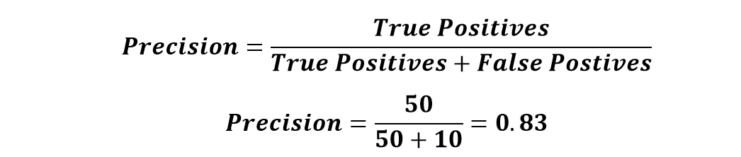
Confusion Matrix - Precision
It is the number of correct positive results divided by the number of positive results predicted by the classifier.
precision emphasizes minimizing false positives.
Use case example: Medical tests, where false positives (Predicted Diseased but actually healthy) can lead to unnecessary treatments.

Slide 19
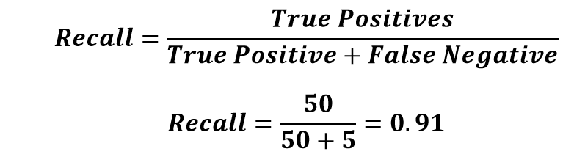
Confusion Matrix - Recall
The ratio of correctly predicted positive instances to the total actual positive instances.
Recall focuses on minimizing false negatives.
Use case example: Disease detection, where False Negative (predicted healthy but actually diseased) can have serious consequences.

Slide 20
Example
A veterinarian builds a machine learning model to detect whether cats have a specific feline disease based on medical test results.
Data:
The vet collected data on 100 cats. Here's a breakdown:
Actually Have the Disease: 40 cats
Actually Healthy: 60 cats
Model Predicted Positive (Disease): 45 cats
Model Predicted Negative (Healthy): 55 cats

Slide 21
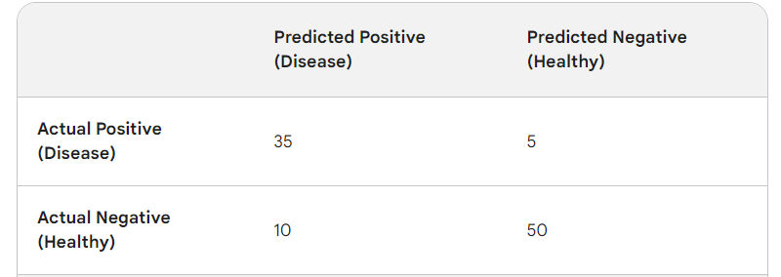
Example

Slide 22
Calculate Precision - Example
Precision = TP / (TP + FP)
Precision = 35 / (35 + 10) = 35/45 = 0.78 (or 78%)
Interpretation: When the model predicts a cat has the disease, it's correct 78% of the time. That means there's a 22% chance of overdiagnosis.

Slide 23
Calculate Recall - Example
Recall = TP / (TP + FN)
Recall = 35 / (35 + 5) = 35/40 = 0.875 (or 87.5%)
Interpretation: For cats that actually have the disease, the model correctly identifies them 87.5% of the time. The remaining 12.5% risk being missed by the model.

Slide 24
Precision Recall Curve
The precision-recall curve shows the tradeoff between precision and recall for different threshold. A high area under the curve represents both high recall and high precision, where high precision relates to a low false positive rate, and high recall relates to a low false negative rate.

Slide 25
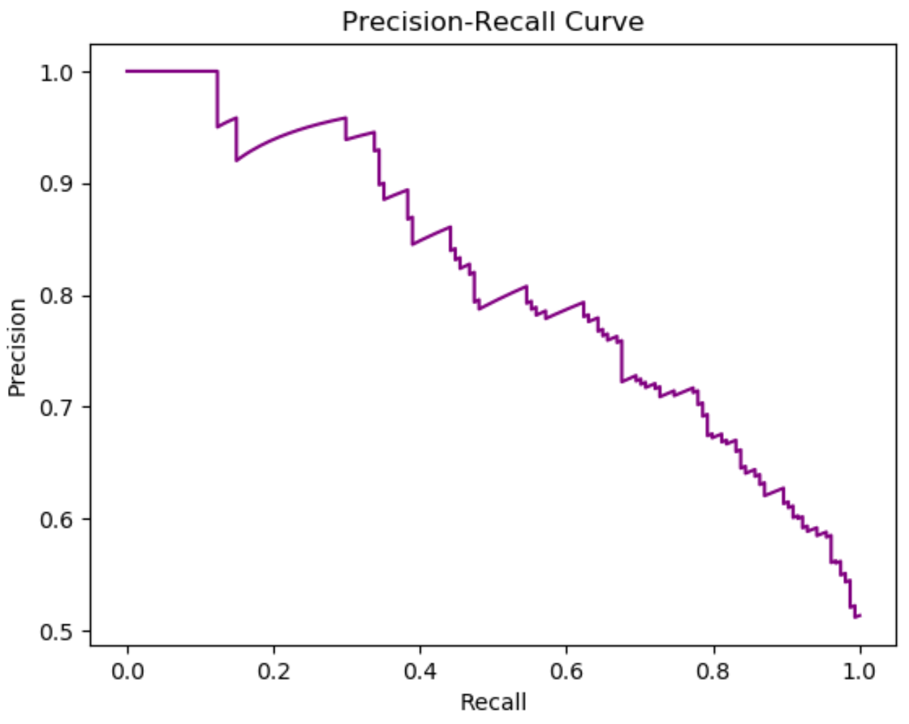
Precision Recall Curve

Slide 26
Confusion Matrix - Example
Suppose you trained a model to classify cancer patients. You want evaluate the model performance. You have to answer the following questions Accuracy? Precision? and Recall?
What should be of more concerned Accuracy. Precision. Recall?
 | Predicted Cancer = Yes | Predicted Cancer = No
Actual Cancer = Yes | 96 | 11
Actual Cancer = No | 17 | 54

Slide 27
Real-World Examples
Fraud detection:
High precision to avoid false positives (Predicted Fraud actually not-Fraud)
Medical diagnoses:
High recall to minimize false negatives (Predicted healthy but actually diseased).

Slide 28
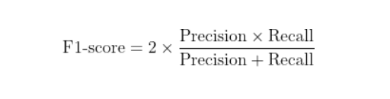
What is the F1-Score?
It's the harmonic mean of precision and recall.
Balances false positives (precision) and false negatives (recall).
Great when you need a single number to summarize model performance.
Especially useful for imbalanced datasets.
F1-score ranges between 0 and 1. The closer it is to 1, the better the model.

Slide 29
F1-Score Example: Disease Diagnosis
Scenario: A model to detect a rare disease
High Recall: The model catches most true cases of the disease (important because missing a diagnosis is dangerous).
Moderate Precision: The model sometimes gives false alarms (further tests are needed).
F1-Score: Gives a balanced view of the overall performance in this scenario.

Slide 30
What is True Positive Rate (TPR)?
Also called "sensitivity" or "recall"
Measures the proportion of actual positives that the model correctly identifies
Formula: TPR = True Positives / (True Positives + False Negatives)

Slide 31
What is True Negative Rate (TNR)?
Also called "specificity"
Measures the proportion of actual negatives that the model correctly identifies
Formula: TNR = True Negatives / (True Negatives + False Positives)

Slide 32
What is False Positive Rate (FPR)?
Measures the proportion of actual negatives that the model correctly identifies
Formula: FPR= False Positive / (True Negatives + False Positives)

Slide 33
AUC-ROC Curve
ROC stands for Receiver Operating Characteristic curve.
It plots the True Positive Rate (TPR) against the False Positive Rate (FPR).
Shows a model's ability to separate positive and negative examples across different thresholds.

Slide 34
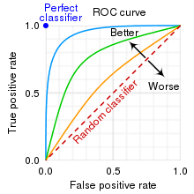
AUC-ROC Curve

Slide 35
What is AUC?
AUC stands for "Area Under the Curve".
It represents the model's overall ability to distinguish classes.
Larger AUC means a better model.
AUC of 1: Perfect model.
AUC of 0.5: No better than random guessing.

Slide 36
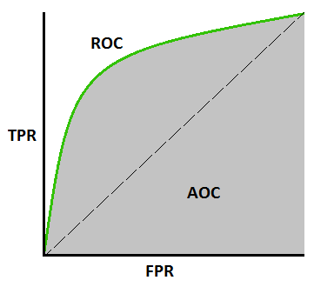
AUC-ROC Curve

Slide 37
AUC-ROC Curve

Slide 38
Evaluation Metrics (Regression)

Slide 39
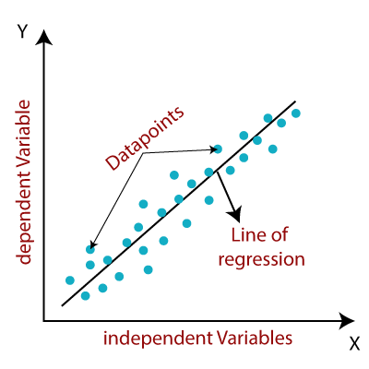
How does Regression work?
It finds the best-fitting line that represents the relationship between X and Y.

Slide 40
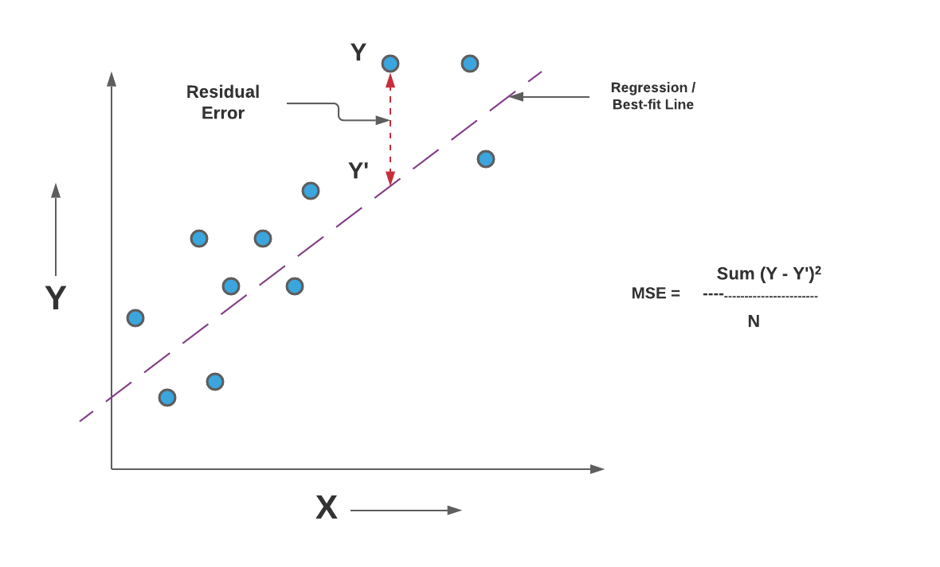
Mean Squared Error (MSE)
The Mean Squared Error (MSE) is a common evaluation metric used in regression tasks.
It measures the average squared difference between the actual and predicted values.

Slide 41
Mean Squared Error (MSE)

Slide 42
Underfitting:
In supervised learning, underfitting happens when a model unable to capture the underlying pattern of the data. These models usually have high bias and low variance. It happens when we have very less amount of data to build an accurate model or when we try to build a linear model with a nonlinear data. Also, these kind of models are very simple to capture the complex patterns in data like Linear and logistic regression.

Slide 43
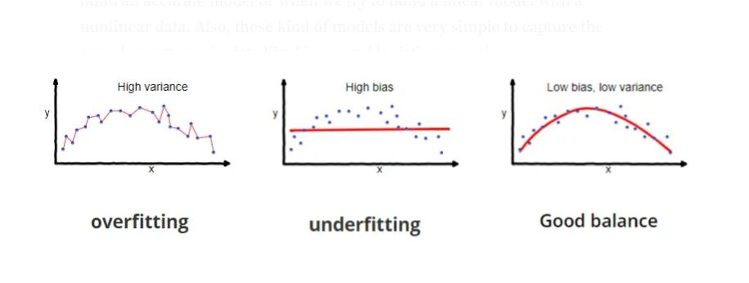

Slide 44
Overfitting:
In supervised learning, overfitting happens when our model captures the noise along with the underlying pattern in data. It happens when we train our model a lot over noisy dataset. These models have low bias and high variance. These models are very complex like Decision trees which are prone to overfitting.

Slide 45
Quiz
https://forms.gle/Fp63y9zjTJ1srfDD6

Slide 46
Next Lecture:
Lecture 22 - Introduction to Deep Learning
Click Here

